Slide 1
meetchewthere
Low-Fi Prototypes and Usability Testing
Presented By: Senthil V.

Slide 2
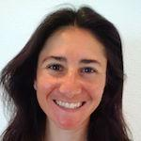
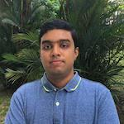

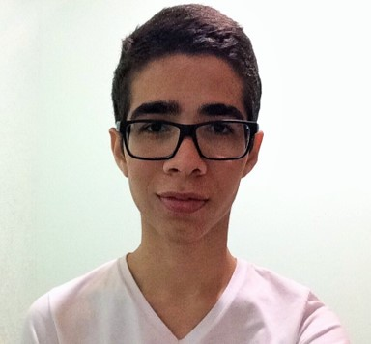
The meetchewthere Team
Lindsey K.
Team Manager
Senthil V.
Designer
Clay J.
Software Engineer
Jesse C.
Usability Testing

Slide 3
Talking Points
What do we want to do? – the meetchewthere mission
How are we going to do it? - design process
From paper to…more paper – meet our prototype
What we think you’ll do - task flows
What you actually do – testing
Unpacking the results

Slide 4
What Do We Want To Do?

Slide 5
Mission
FEED YOUR SOCIAL CRAVINGS

Slide 6
How Are We Going to Do It?
Sketches

Slide 7
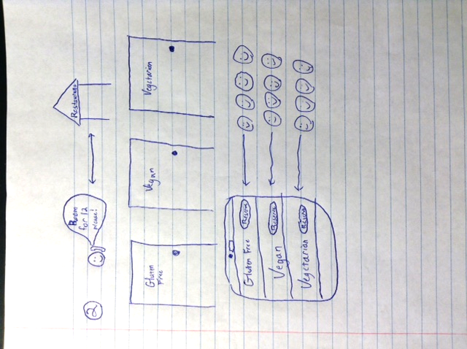
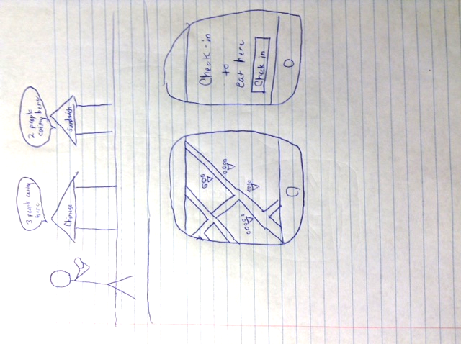
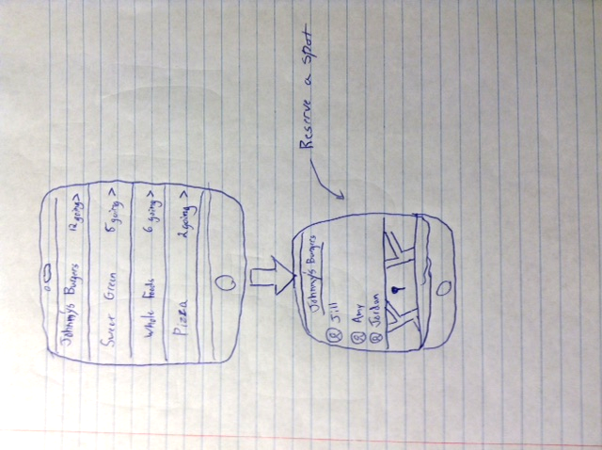
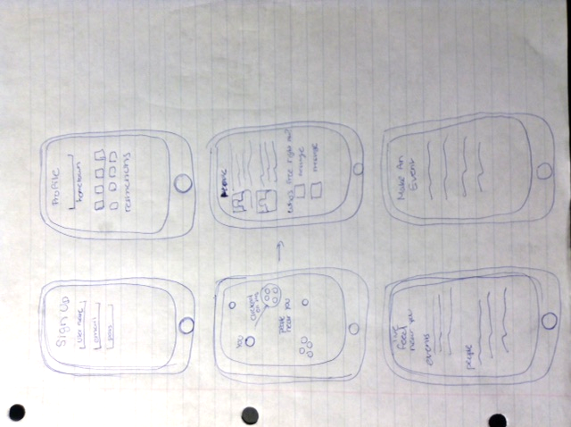
Sketches
Geographically Focused Mobile Solutions

Slide 8
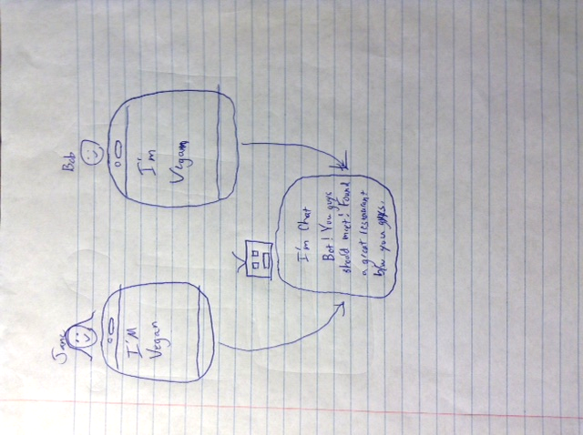
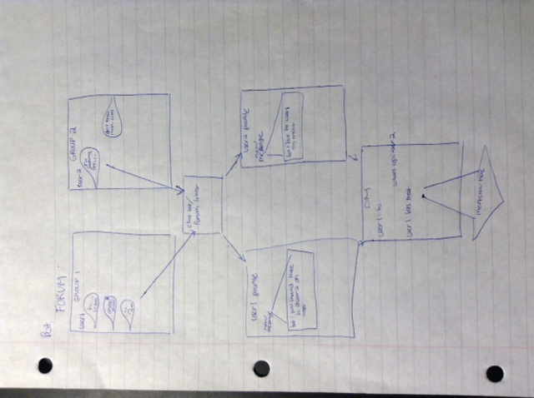
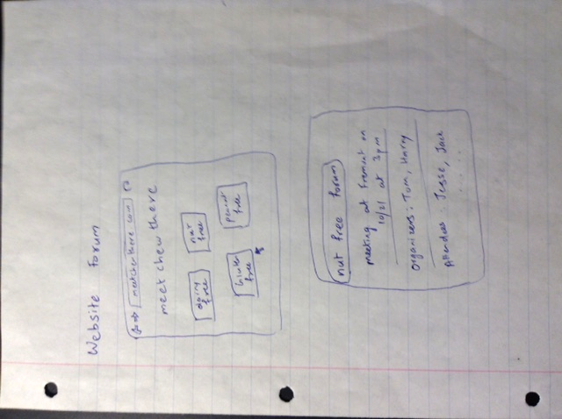
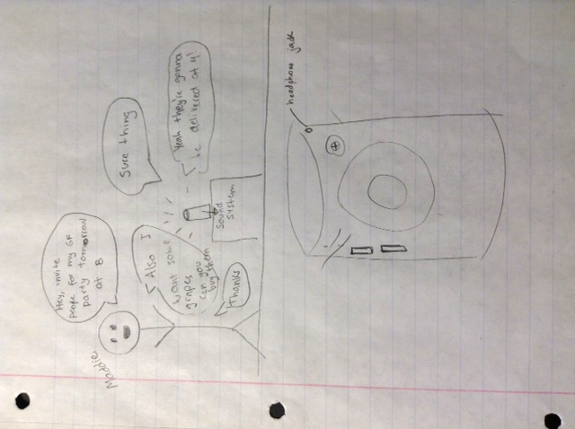
Sketches
Chat Based Solutions

Slide 9
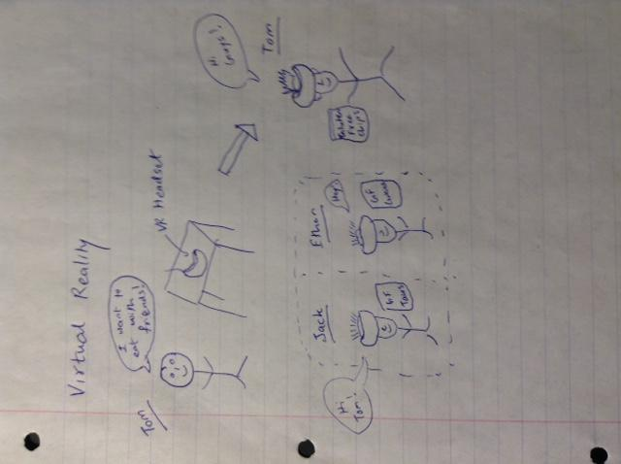
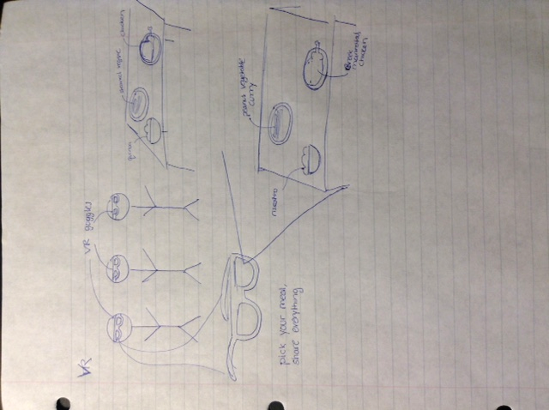
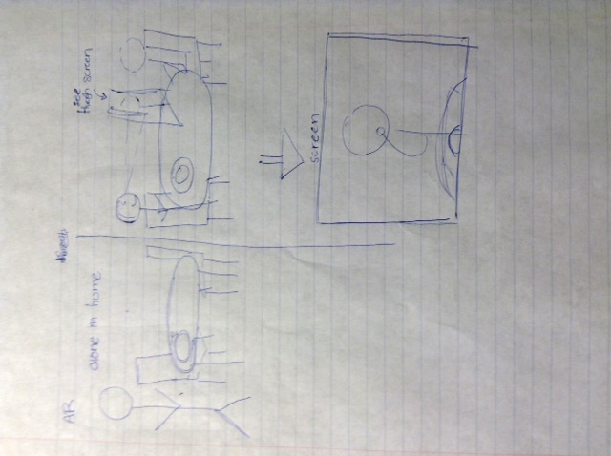
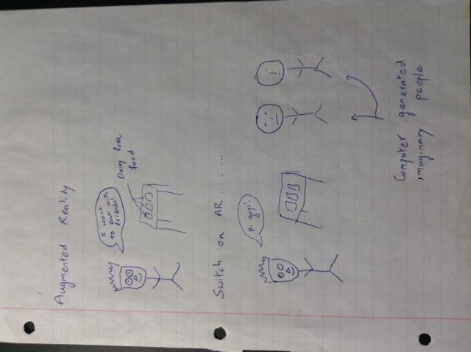
Sketches
Augmented/Virtual Reality

Slide 10
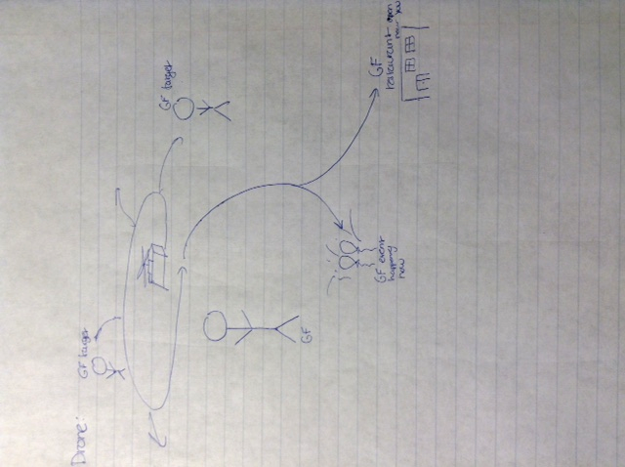
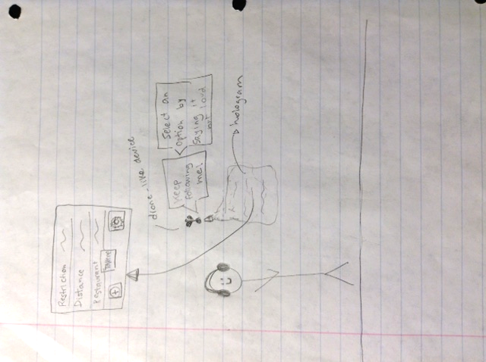
Sketches
Drones

Slide 11
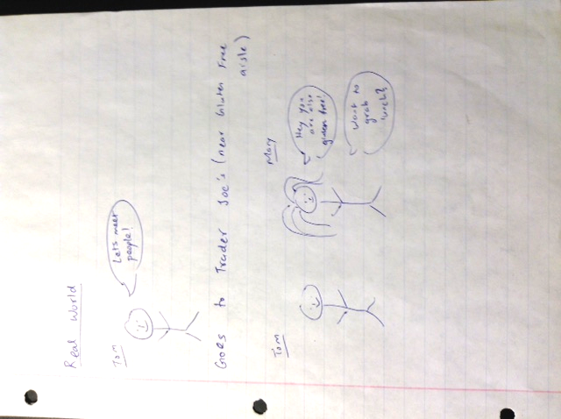
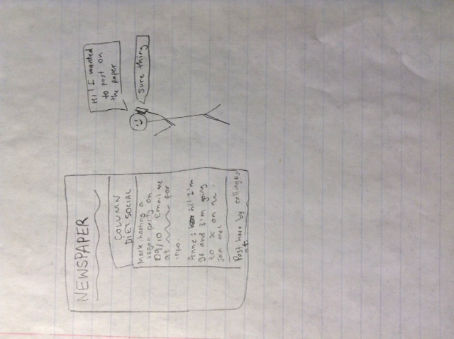
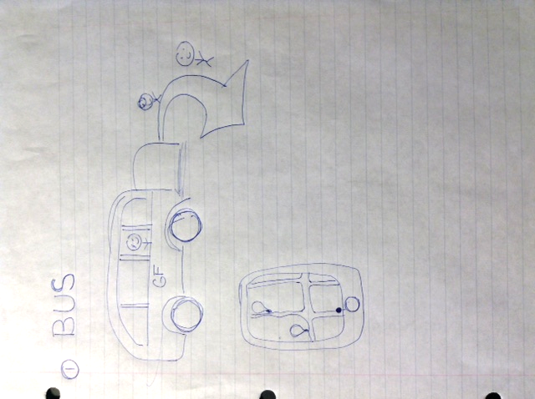
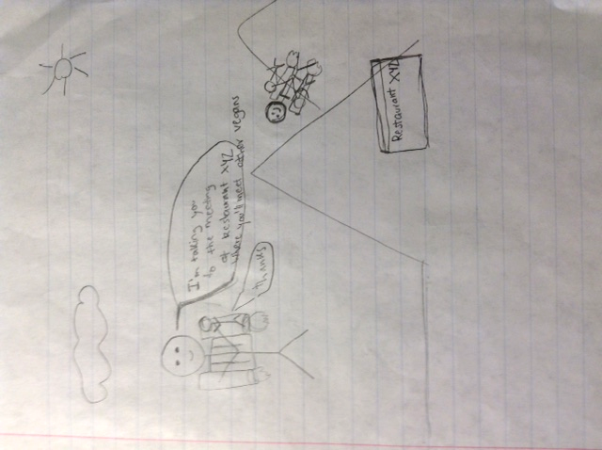
Sketches
The Extremely Practical and Extremely Out-there Solutions

Slide 12
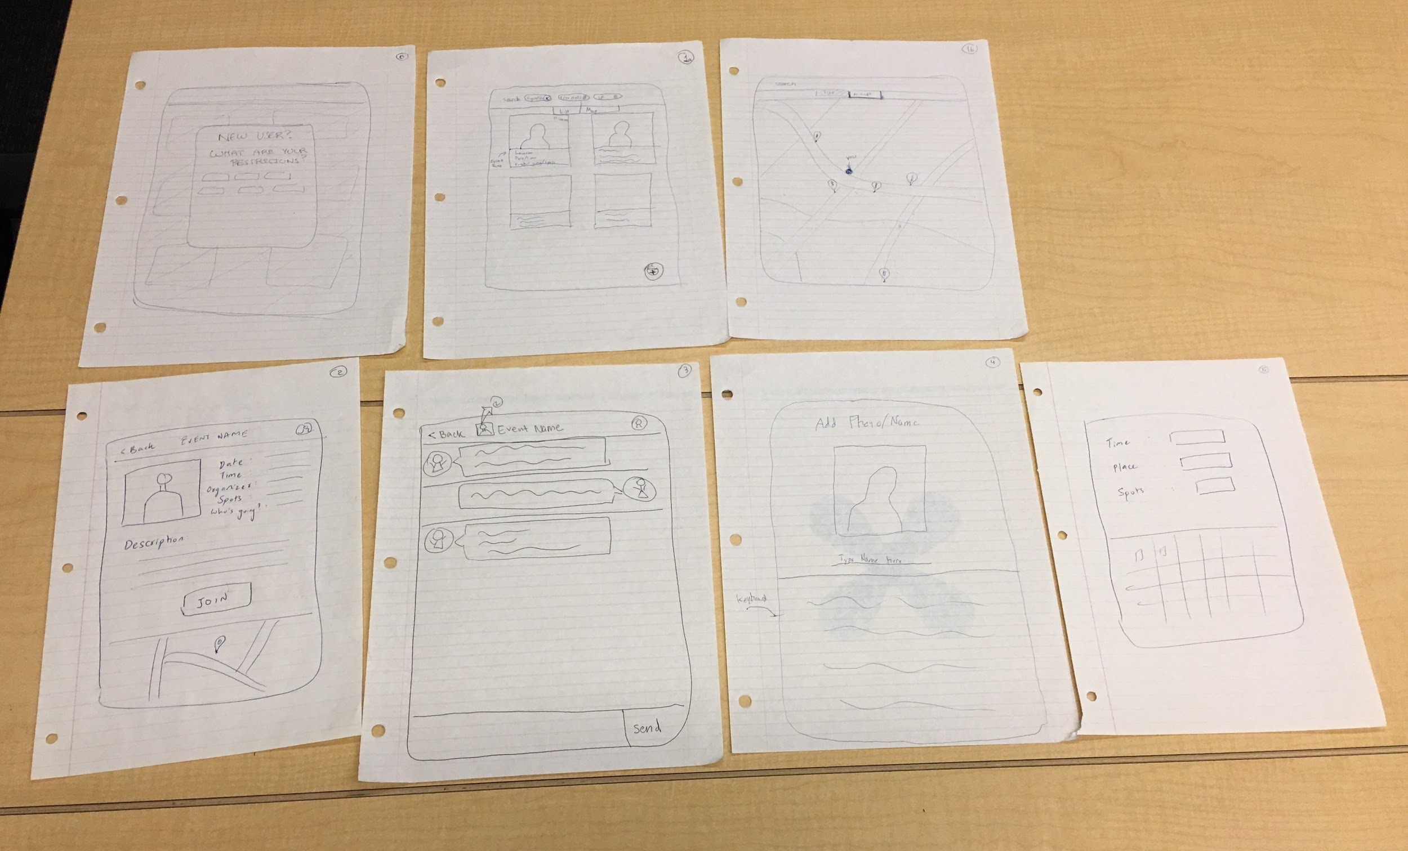
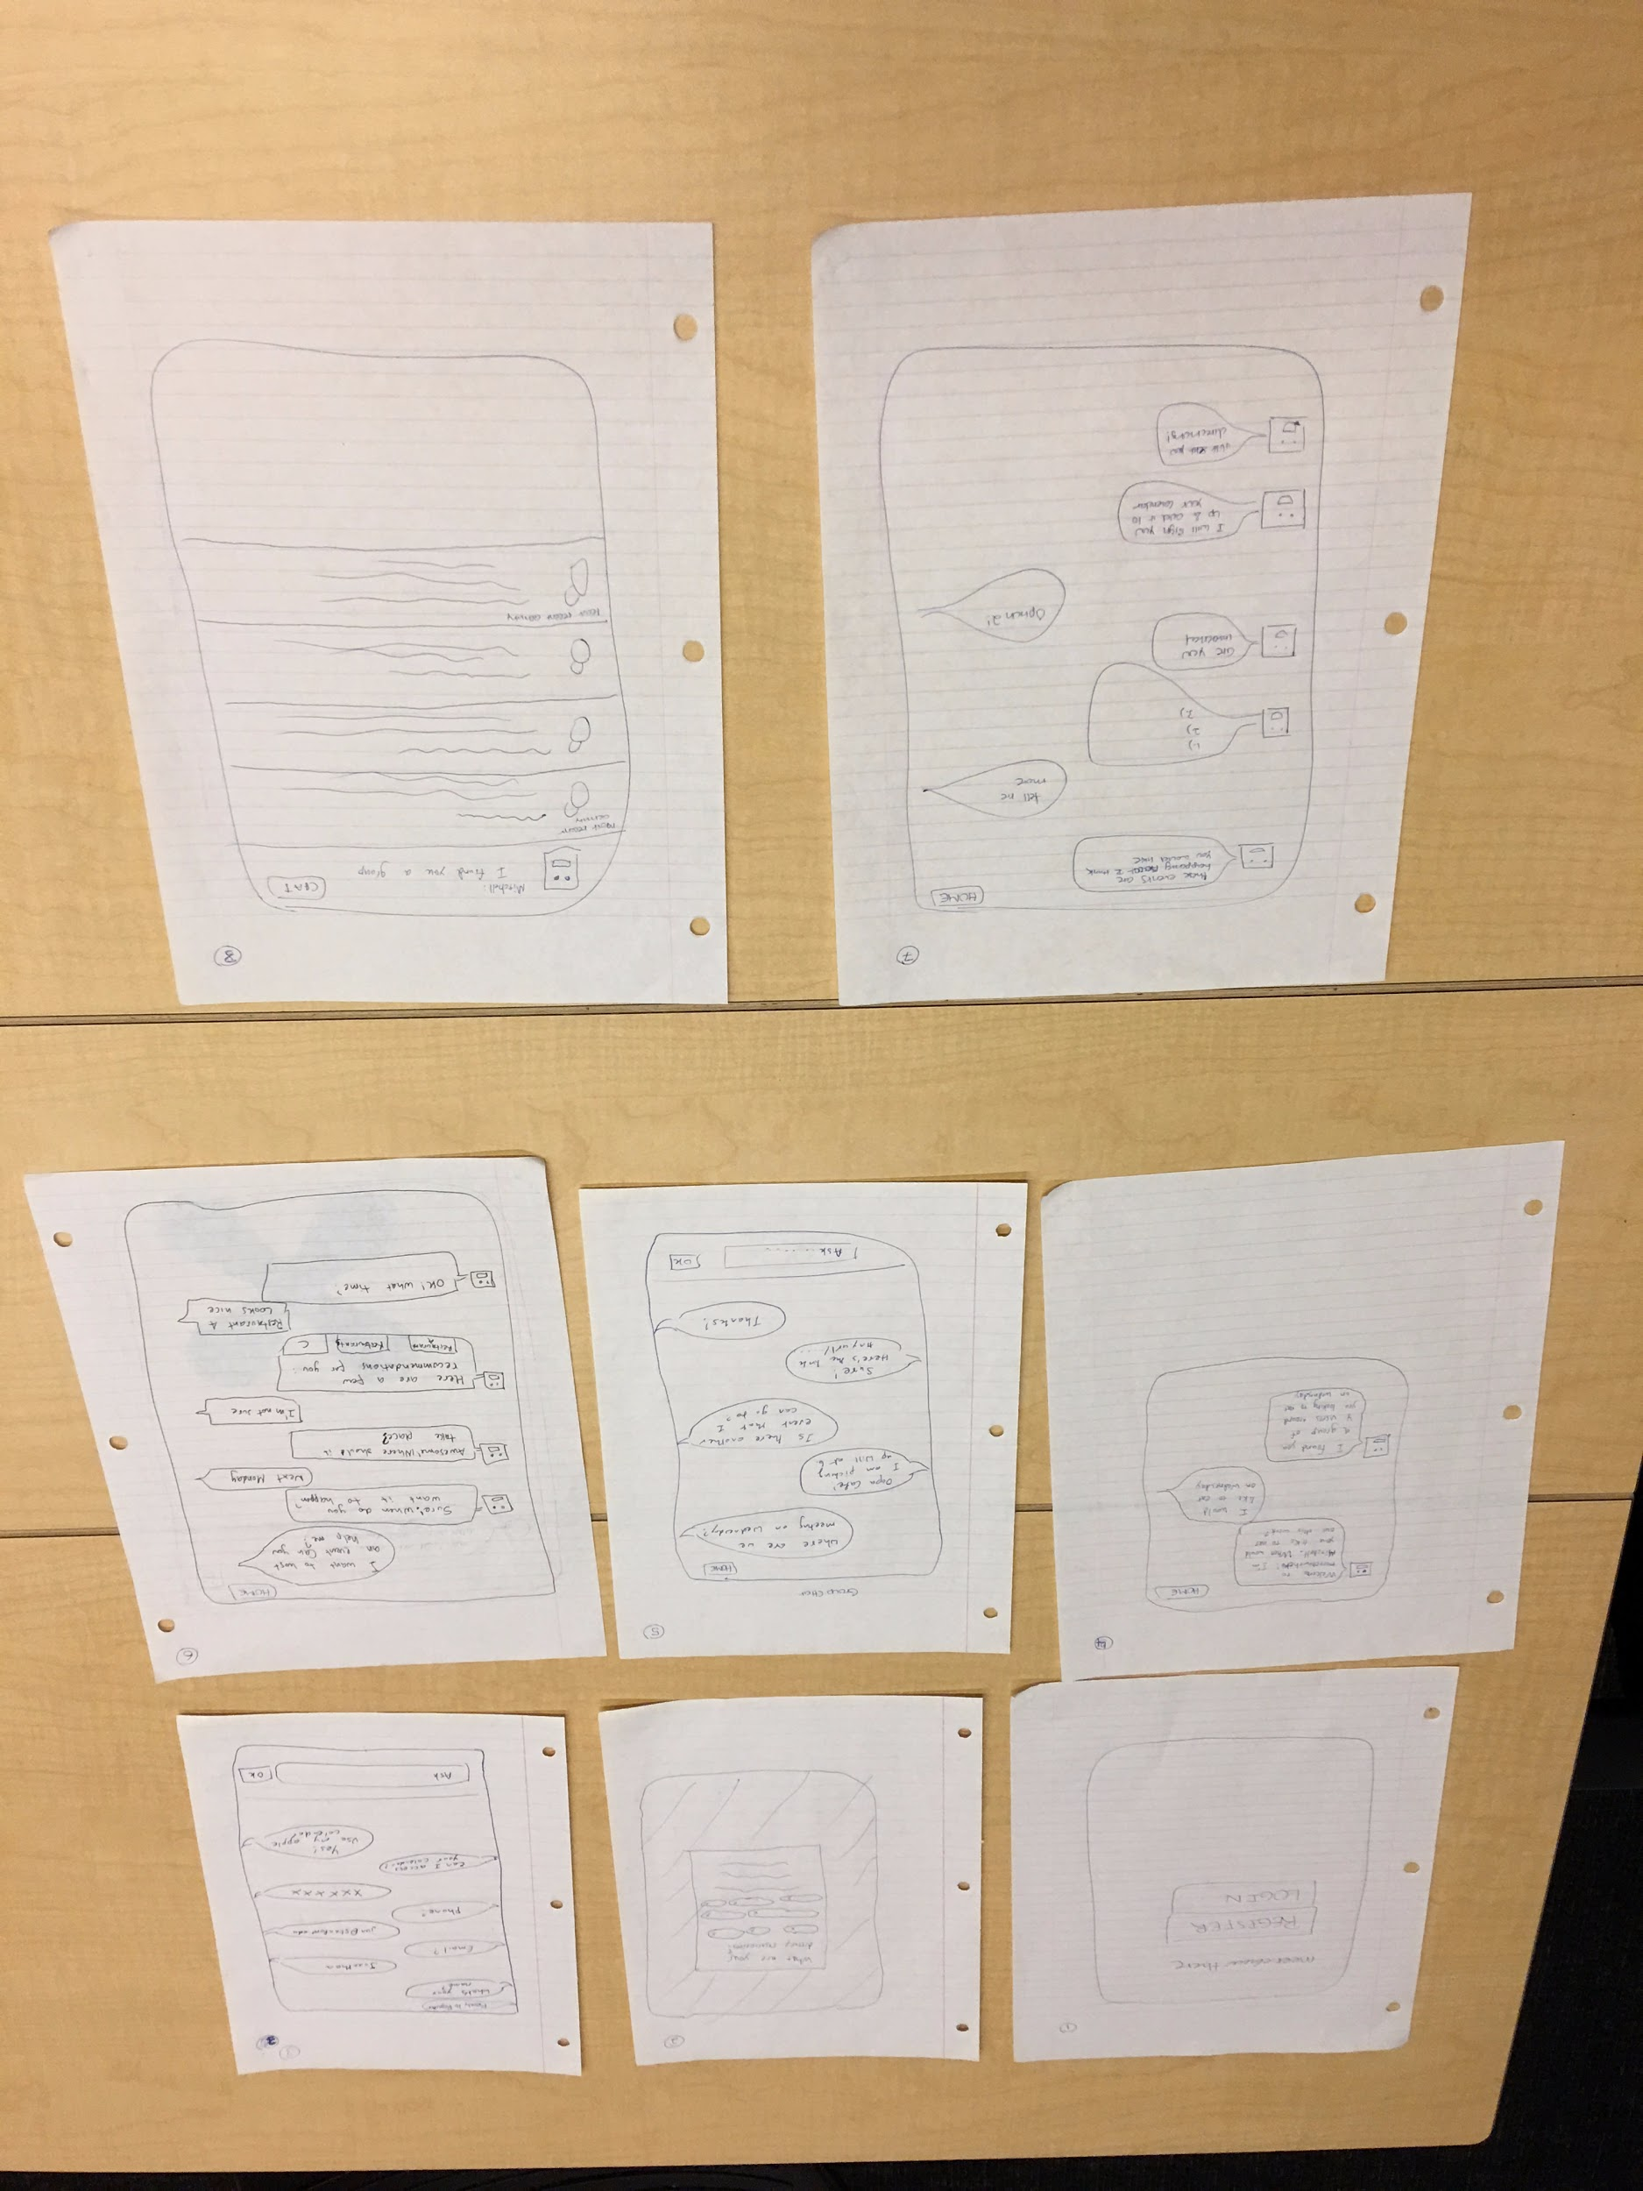
The Final Two
Location Based Mobile App
ChatBot
Notes:
briefly describe chatbot and mobile app

Slide 13
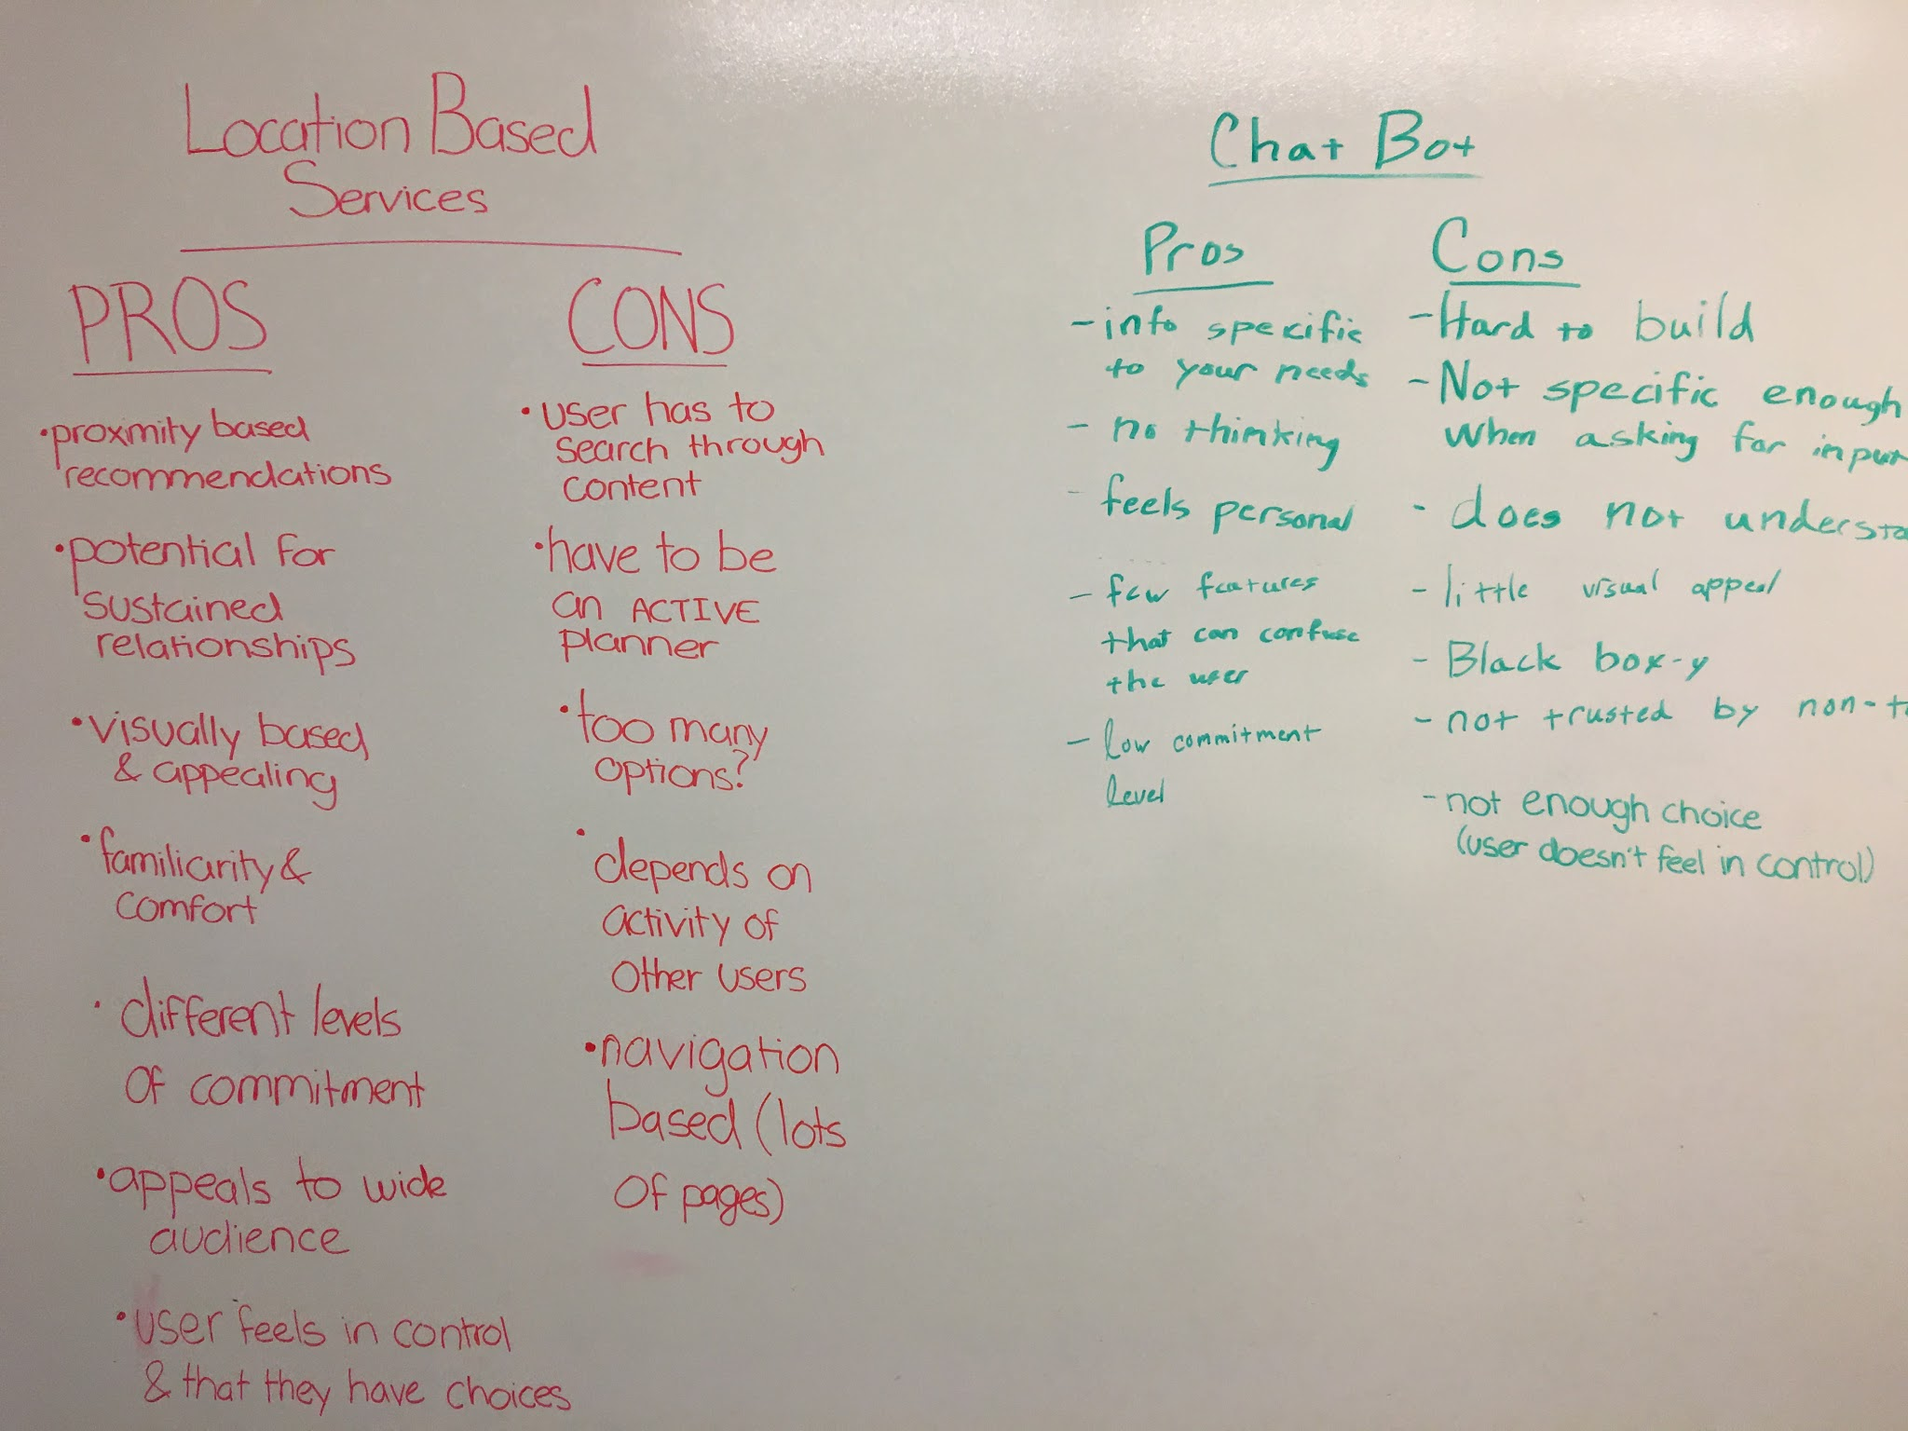
Pros/Cons
Notes:
talk about the pros and cons and then which one we chose and why once you flip to next two slides

Slide 14
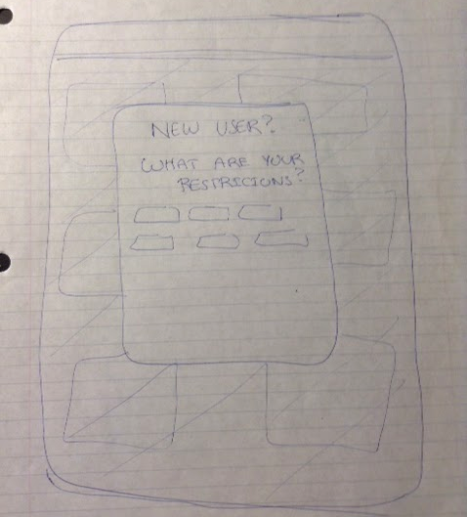
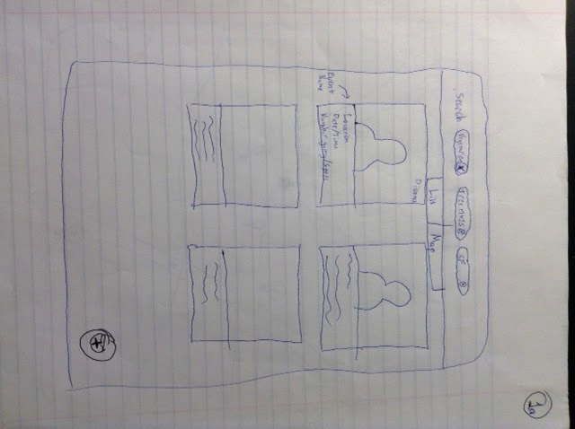
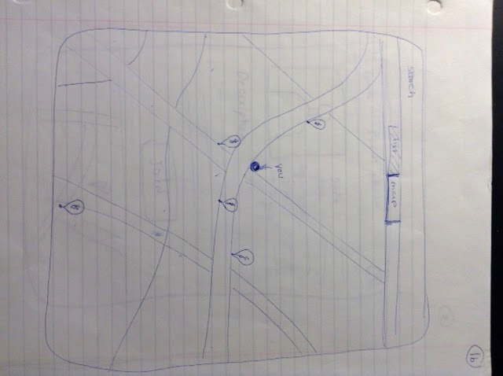
The Champion
Location Based Mobile App
Set Restrictions
List View Home
Map View Home
Add an Event
Event Details

Slide 15
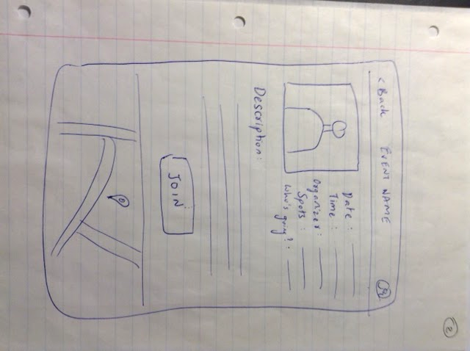
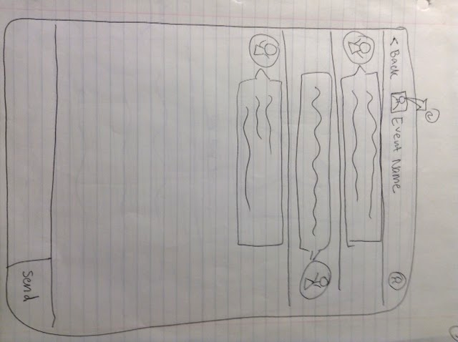
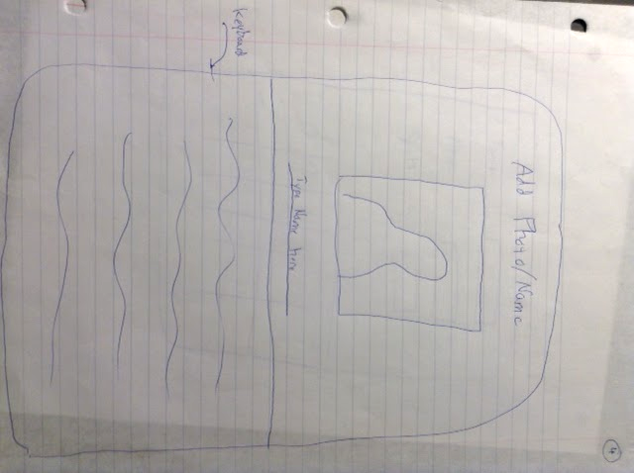
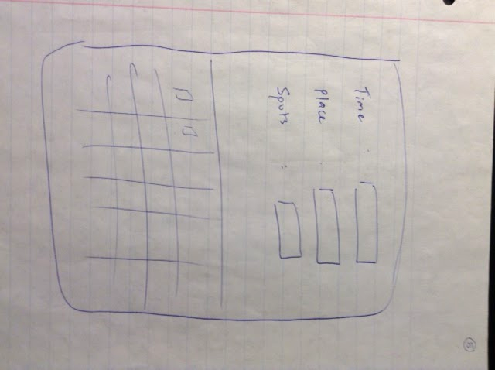
The Champion
Location Based Mobile App
Event Page
Event Chat
Create Event
Your Event Details

Slide 16
From Paper To…More Paper
The Prototype

Slide 17
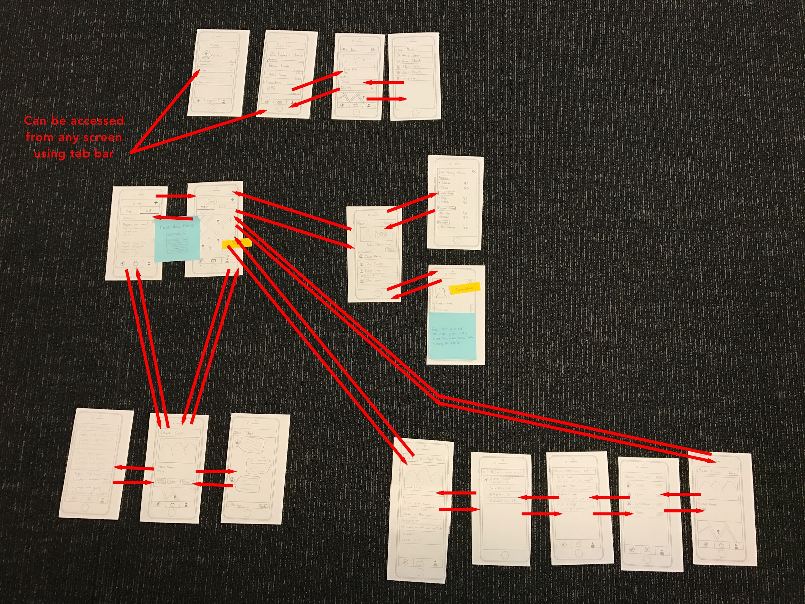
Low-Fi Prototype

Slide 18
What We Think You’ll Do
Task Flows
Notes:
make sure you are clear on the functionality of each component and how the user carries out each task!

Slide 19
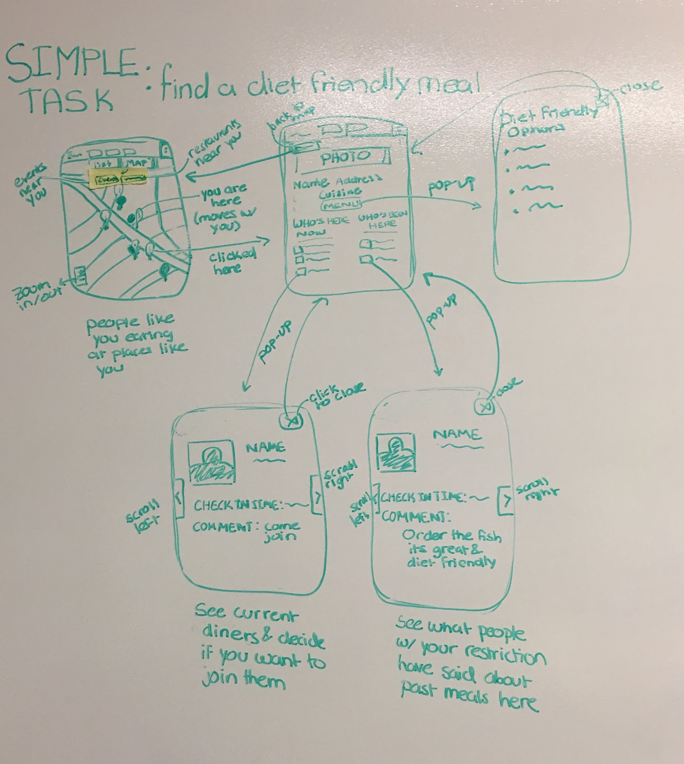
Simple Task
Locate a convenient diet friendly meal

Slide 20
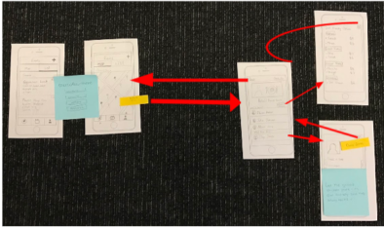
Simple Task
Locate a convenient diet friendly meal
Notes:
key features: can search using search bar of map view. 2 color pins represent events and restaurants. once clicked can see list of diet friendly menu options, users who are their now and users who have been their in the past and their comments

Slide 21
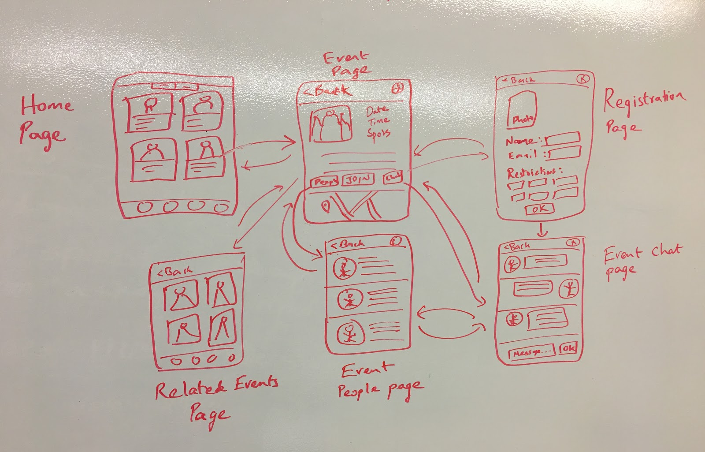
Moderate Task
Join a group/event with people who share your restriction(s)

Slide 22
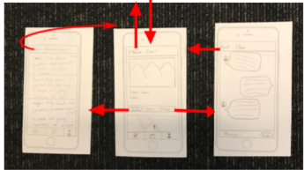
Moderate Task
Join a group/event with people who share your restriction(s)
Notes:
key features: list view homepage is an events near you feed or you can search using search bar. once clicked can see event details, or click links to related events and once joined you can enter the event group chat

Slide 23
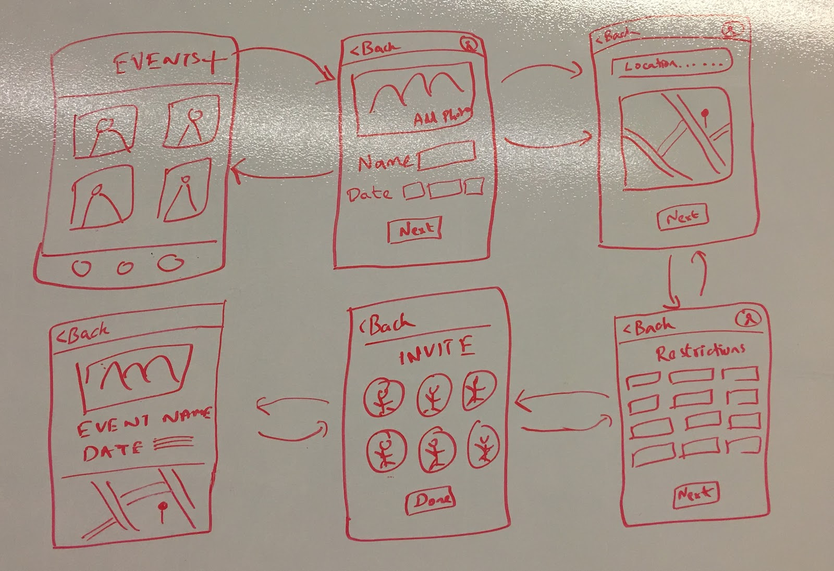
Complex Task
Create your own event for people who share your restriction

Slide 24
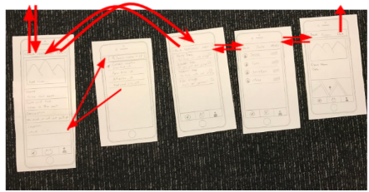
Complex Task
Create your own event for people who share your restriction
Notes:
key features: pressing the plus button on the home screen lets you create your own event, enter info on a series of pages (including event description and diet restrictions) then given a list of recommended friends you can choose to explicitly invite (others may join as well)

Slide 25
Low-Fi Prototype

Slide 26
What You Actually Do
Usability Testing

Slide 27
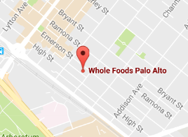
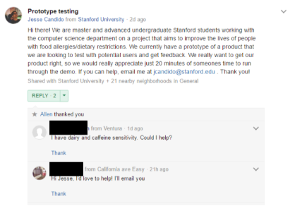
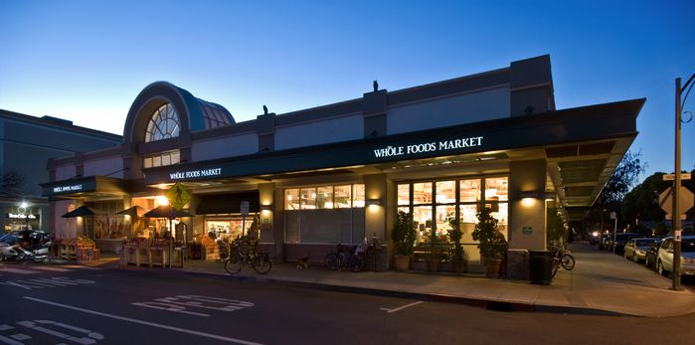
Recruitment
Notes:
needed to find people with food sensitivities and allergies
1 - asked past interviewees to connect us with any friends they had who fit our target population
2 - posted a solicitation on Nextdoor.com
3 - approached shoppers in the aisles of safeway on Monday morning and whole foods on Tuesday evening. we explained our purpose and we asked shoppers who self-identified as having a food allergy if they would test our prototype in-store after they finished shopping.
the grocery stores and nextdoor were successful and provided us with our three participants

Slide 28
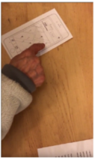
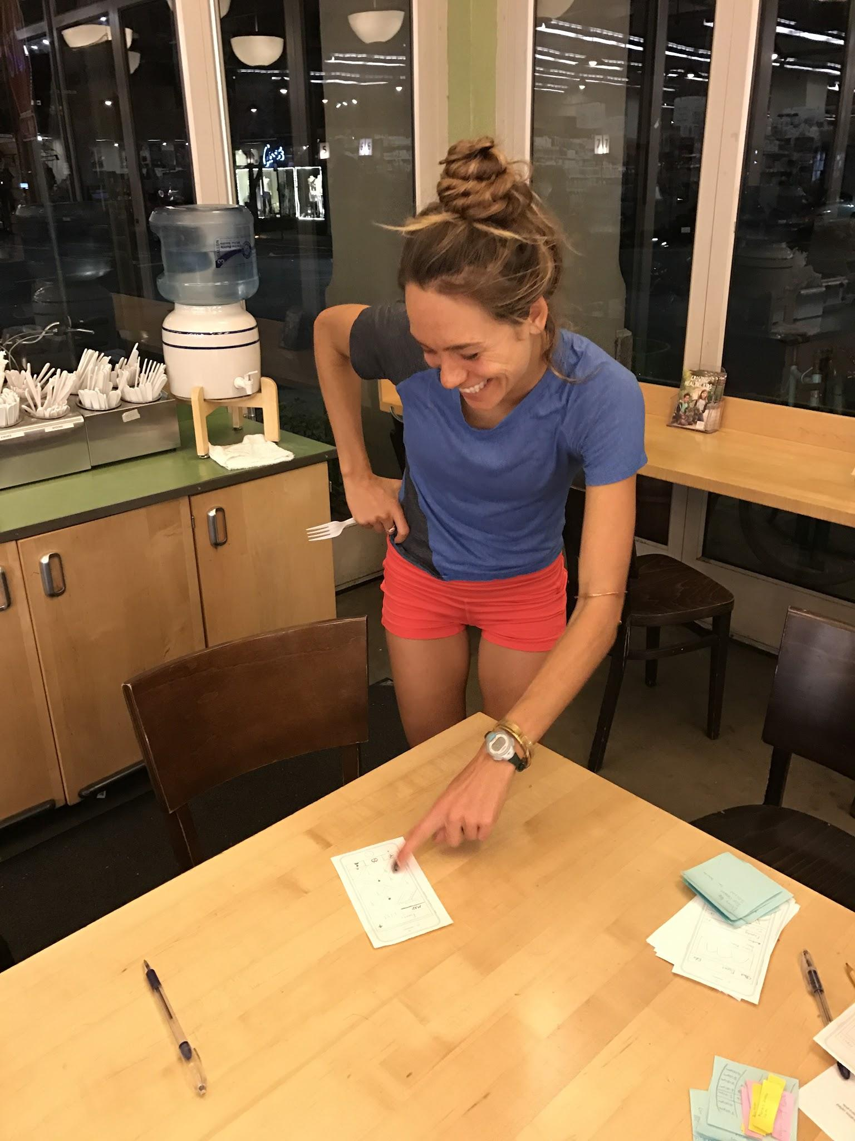
Participants
Participants 1&2
Participant 1
Participant 2
QUICK TAKES
early-60’s
gluten and dairy allergies
LOW tech savvy
low on social scale
WF cereal aisle
QUICK TAKES
late-20’s
vegetarian; dairy allergy
high tech savvy
high on social scale
WF hot food section

Slide 29
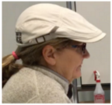
Participants
Participant 3
QUICK TAKES
late-50’s
dairy and caffeine allergies
med/low tech savviness
med/low social

Slide 30
Measures
Product and Feature Interest
Over/Under Featurization
User-User Communication
Usability
Notes:
1 - we wanted to get a general sense of whether participants even liked the product and also which features the did/didn’t like or value - we measured this by noting participant engagement before, during, and after the tasks and test
2 - we discussed the concern of over-featuring ourselves when creating the prototype - we wanted something that provided all the functionality we thought our users would need and want without becoming too overwhelming an confusing. we wanted to test how over/under featured the prototype was so we evaluated if, when, and how participants were distracted or struggled during a given task by noting the time it took for a user to complete the task and their levels of frustration
3 - going off of this concern for over-featurization our team was split on the role that chat and user-user interaction should play in our product so we wanted measure the desirability of these features by observing how and with what frequency participants engaged or attempted to engage in some form of user-user communication
4 - we made a lot of UI assumption in terms of button and feature placement on a given screen and within the flow of the app and we needed to see if our assumptions matched the intuition of our users so we paid explicit attention to how often participants were unsure of how to navigate thr prototype or made “incorrect” assumptions according to our design

Slide 31
Roles, Tasks, & Procedure
ROLES
Lindsey - Script Writer/Facilitator
Clay - Videographer/Note-Taker & Computer
Senthil - Computer
Jesse - Videographer/Note-Taker
TASKS
Simple: Find a Meal
Moderate: Join a Group/Event
Complex: Host an Event
Notes:
mention roles and tasks briefly, say we tested 1&2 in store at the dining area and 3 in lathrop tech lounge study room with 3 team members, after introductions lindsey gave a brief overview of the test and confirmed consent and then the test began. the test was followed by a short debreif session.

Slide 32
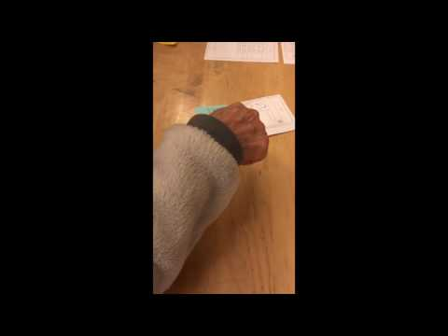
Task 1
Locate a convenient diet friendly eatery

Slide 33
Task 1 Observations
Different Colored Pins
Search Bar Usage
Clickable Menu
User-User Interaction
Notes:
1 - they didn’t notice/understand the content signaled by the different colored pins
2 - no one attempted to use the search bar to help them find things, they just kept rejected what was on the screen
3 - they either tried to click on menu items for more info or to order that item, didn’t seem to understand those were just a list of diet friendly options
4 - they all wanted to read all the comments from all the current and past visitors of the restaurant (we hadn’t prepared for this so we had to scramble to keep writing sticky note comments until they were satisfied)

Slide 34
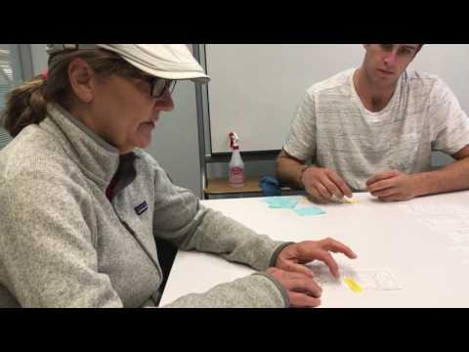
Task 2
Join a Group/Event

Slide 35
Task 2 Observations
Search Bar Usage
Strangers vs Friends
Chat Functionality
Notes:
1 - again no one enlisted the help of the search bar. interestingly though no one complained or commented on not having one/not finding one - it just went completed unnoticed
2 - participants 1 and 3 made explicit mention about being unsure of joining groups of strangers - they tried to do more research on the people in the event
3 - they all entered the event group chat, participant 3 misused it by sending messages to her friends and daughter to join her at this event

Slide 36
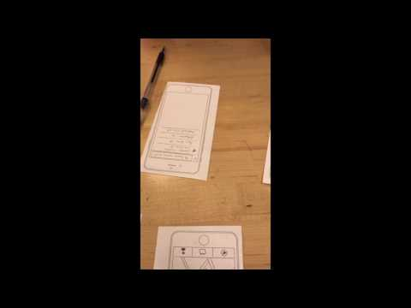
Task 3
Host an Event

Slide 37
Task 3 Observations
“Add Event” Button
Event Attendee Controls
Invited All Their “Friends”
Easy and Enjoyable Process
Notes:
1 - everyone struggled to find the add event button located as a plus at the top of the home screen - they went looking for it on their profile and events pages
2 - participants 1 and 3 made explicit mention about wanting to limit their guests to their friends when setting the controls for their event
3 - all participants invited all their suggested friends without hesitation
4 - after finding the create event page they each proceeded with ease and enjoyment - they especially enjoyed setting the description and inviting their friends

Slide 38
Unpacking the Results

Slide 39
OBSERVATION | ANALYSIS | UI IMPROVEMENT
Map View - multi-color pins
Lack of Search Bar Usage
Desire to Control Event Attendees
User-User Communication Attempts
Finding the “Add Event” Button
In-depth Search of Restaurants and Events/Groups
Inviting all Recommended Friends
Distraction during Task 1

Slide 40
OBSERVATION | ANALYSIS | UI IMPROVEMENT
Map View - multi-color pins | unintuitive map-view content due to insufficient homepage
Lack of Search Bar Usage | unnoticed - insufficient introduction to the platform/ homepage
Desire to Control Event Attendees | privacy and logistical concerns for certain users
User-User Communication Attempts | communication enhances user experience and trust in product
Finding the “Add Event” Button | unintuitive location
In-depth Search of Restaurants and Events/Groups | misunderstanding of or insufficient trust in the product
Inviting all Recommended Friends | getting users to build communities of in-app friends is key
Distraction during Task 1 | may not fit with rest of product, not valuable (too -”Yelp-y”)?

Slide 41
OBSERVATION | ANALYSIS | UI IMPROVEMENT
Map View - multi-color pins | unintuitive map-view content due to insufficient introduction before page | move to later screen; display dual content differently
Lack of Search Bar Usage | unnoticed - insufficient introduction to the platform/ homepage | more traditional homescreen that better frames the product
Desire to Control Event Attendees | privacy and logistical concerns for certain users | public/private controls
User-User Communication Attempts | communication enhances user experience and trust in product | more robust communication features
Finding the “Add Event” Button | unintuitive location | add button to profile and my events pages
In-depth Search of Restaurants and Events/Groups | misunderstanding of or insufficient trust in the product | more traditional homescreen that better frames the product
Inviting all Recommended Friends | getting users to build communities of in app friends is key | more explicit within app community building features
Distraction during Task 1 | may not fit with rest of product, not uniquely valuable (too “Yelp-y?”) | revise/eliminate features?

Slide 42
Thank You

Slide 43
Index

Slide 44
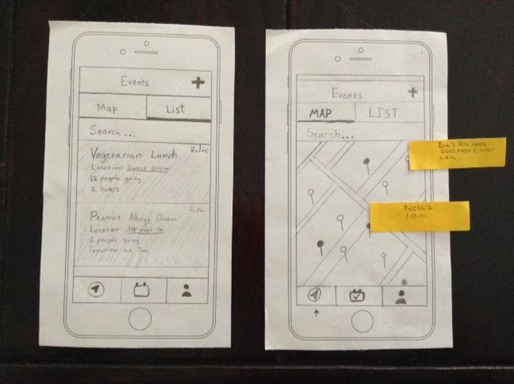
Homepages

Slide 45
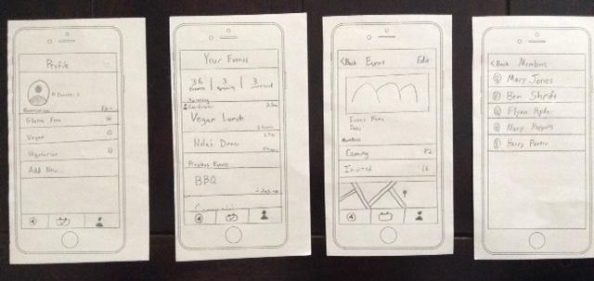
Profile Pages

Slide 46
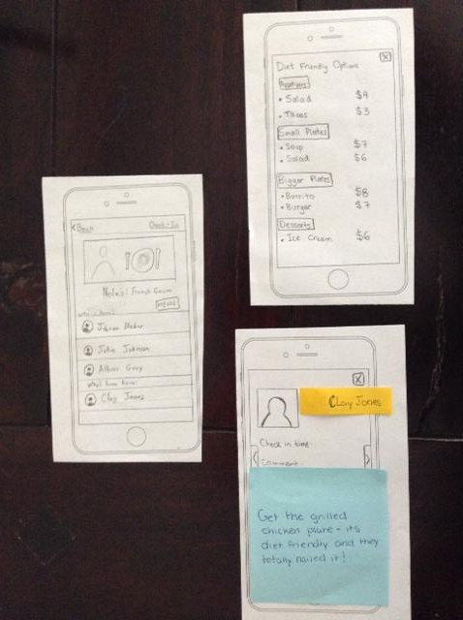
Task 1 - Find a Meal

Slide 47

Task 2 - Join a Group

Slide 48

Task 3 - Create an Event

